Slide 1
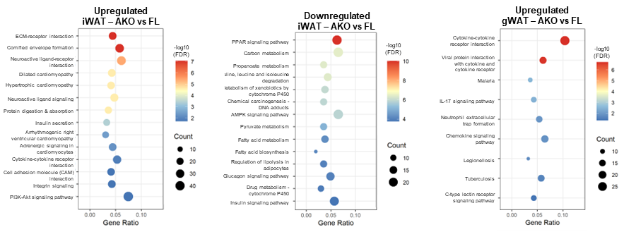
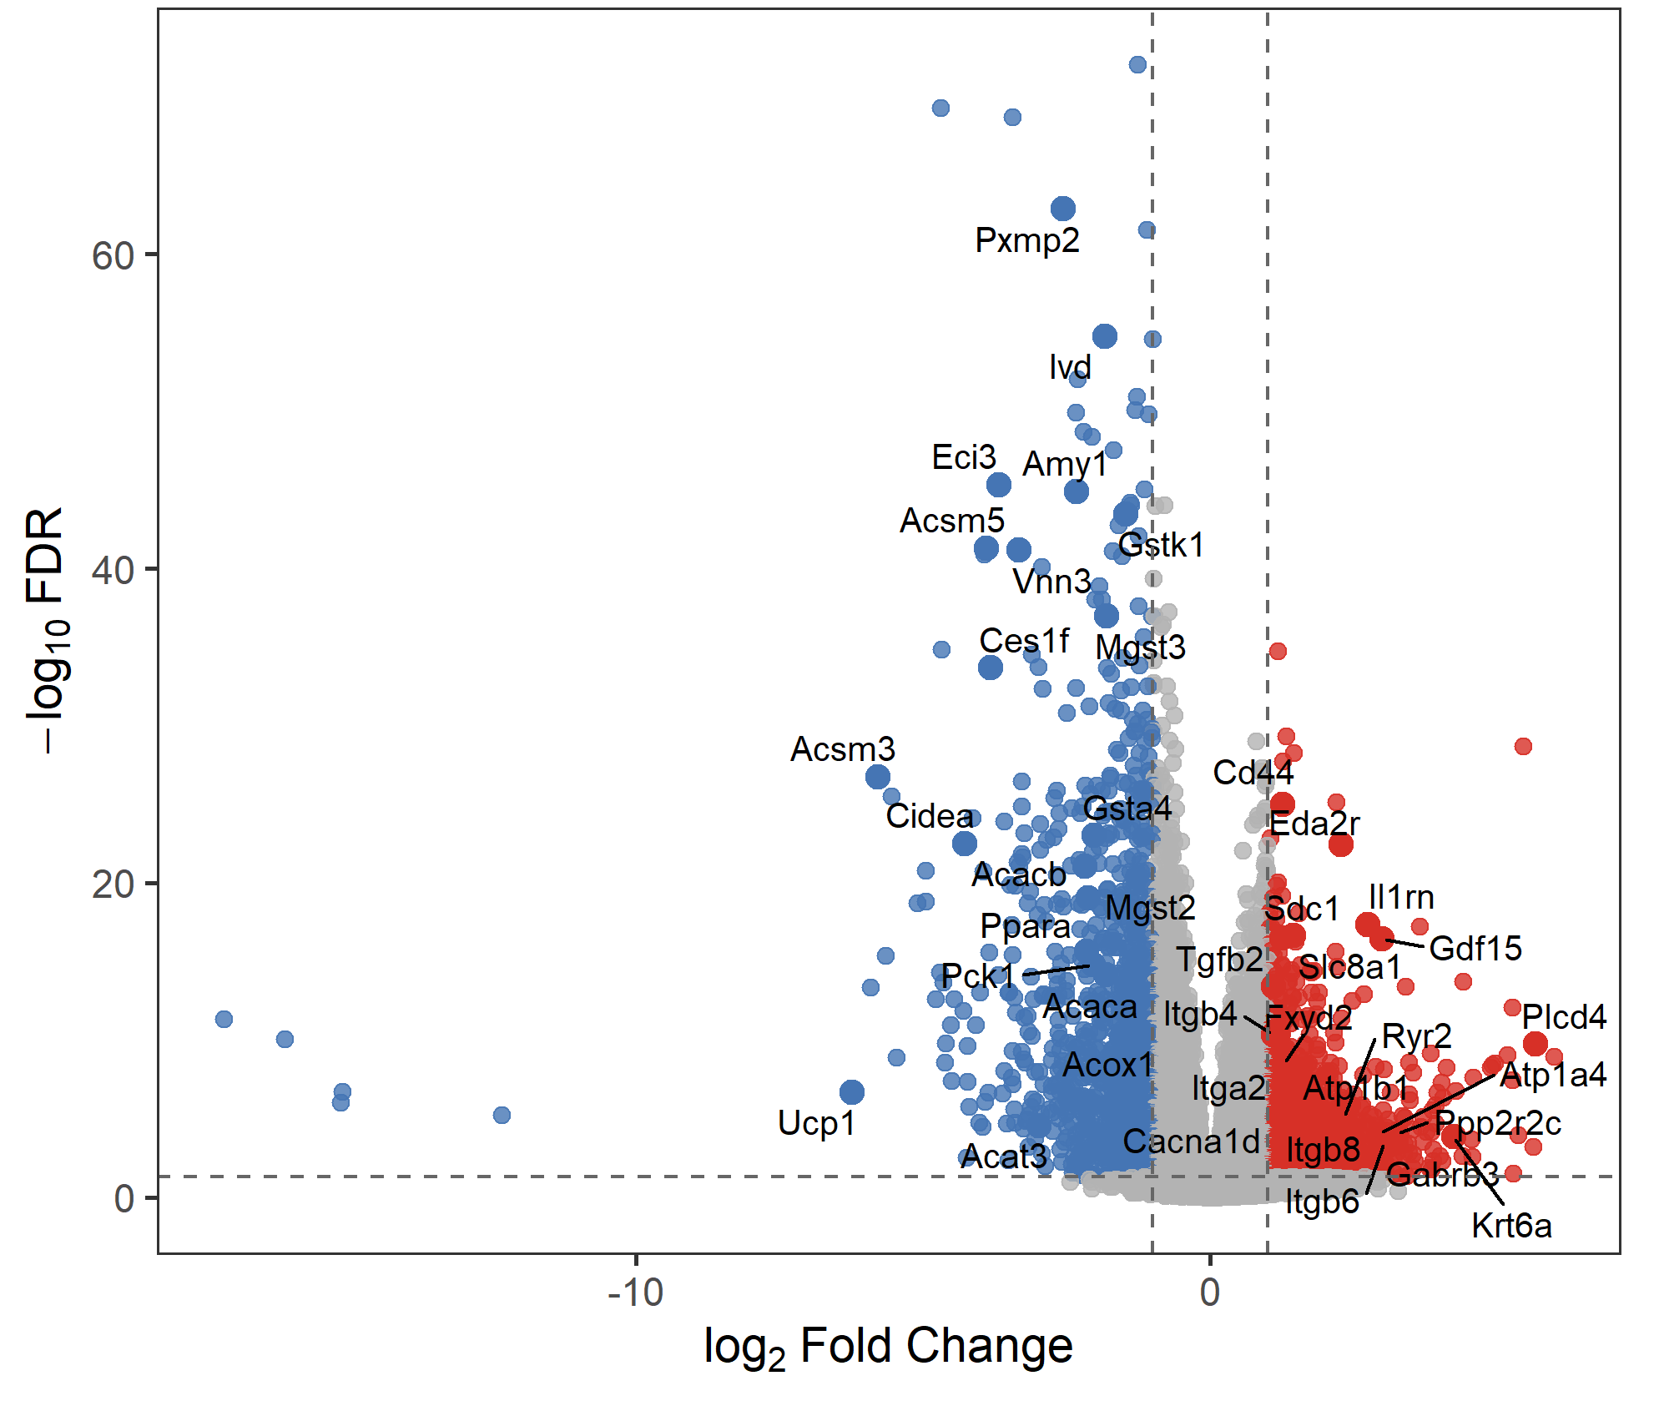
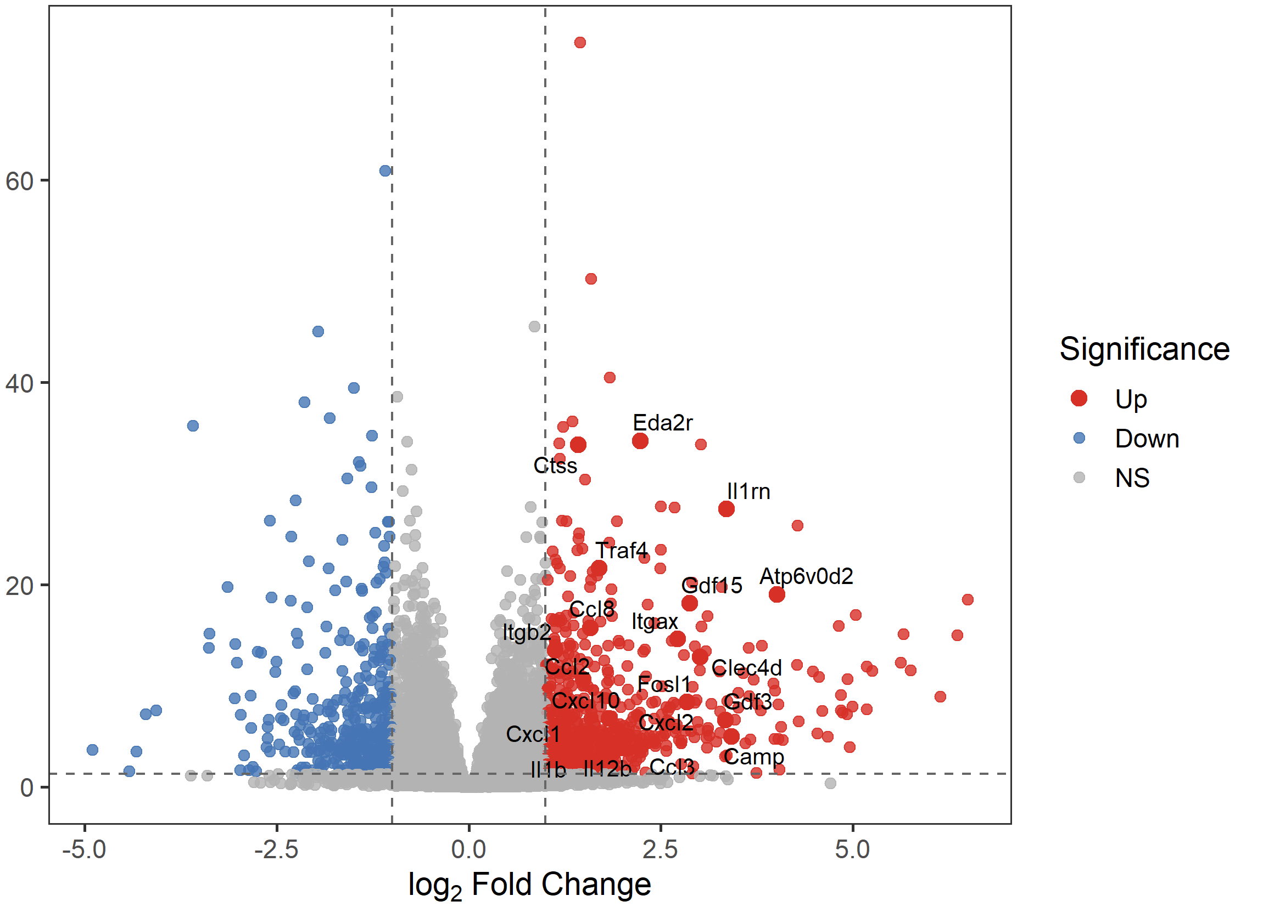
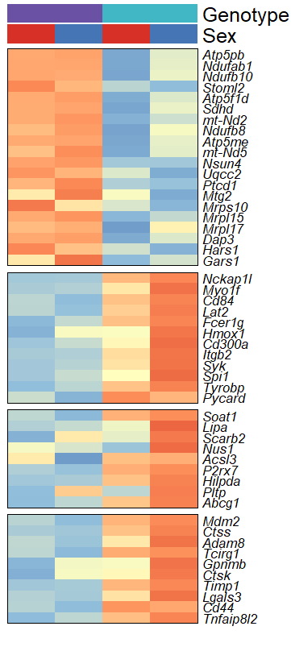
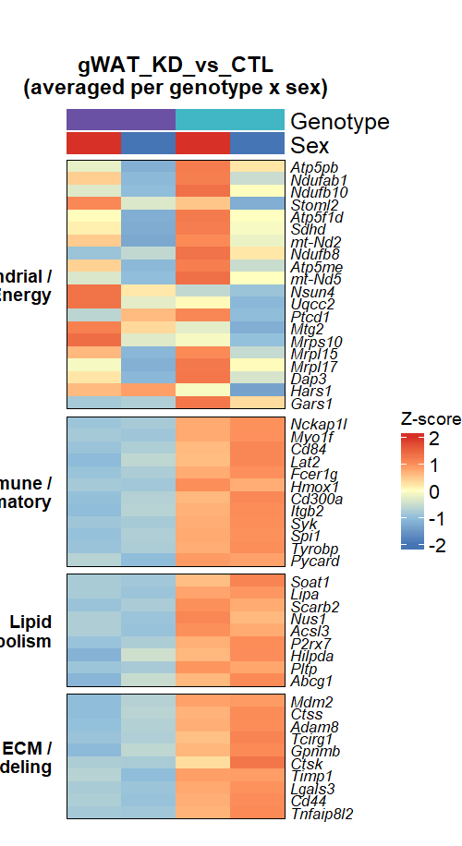
A
B
iWAT – AKO vs FL
gWAT – AKO vs FL
C
iWAT
gWAT
Mitochondrial/ Energy
Mitochondrial/ Energy
Immune/ Inflammatory
Immune/ Inflammatory
Genotype
FL
AKO
F
M
Lipid Metabolism
Lipid Metabolism
ECM/ Remodeling
ECM/ Remodeling

Slide 2
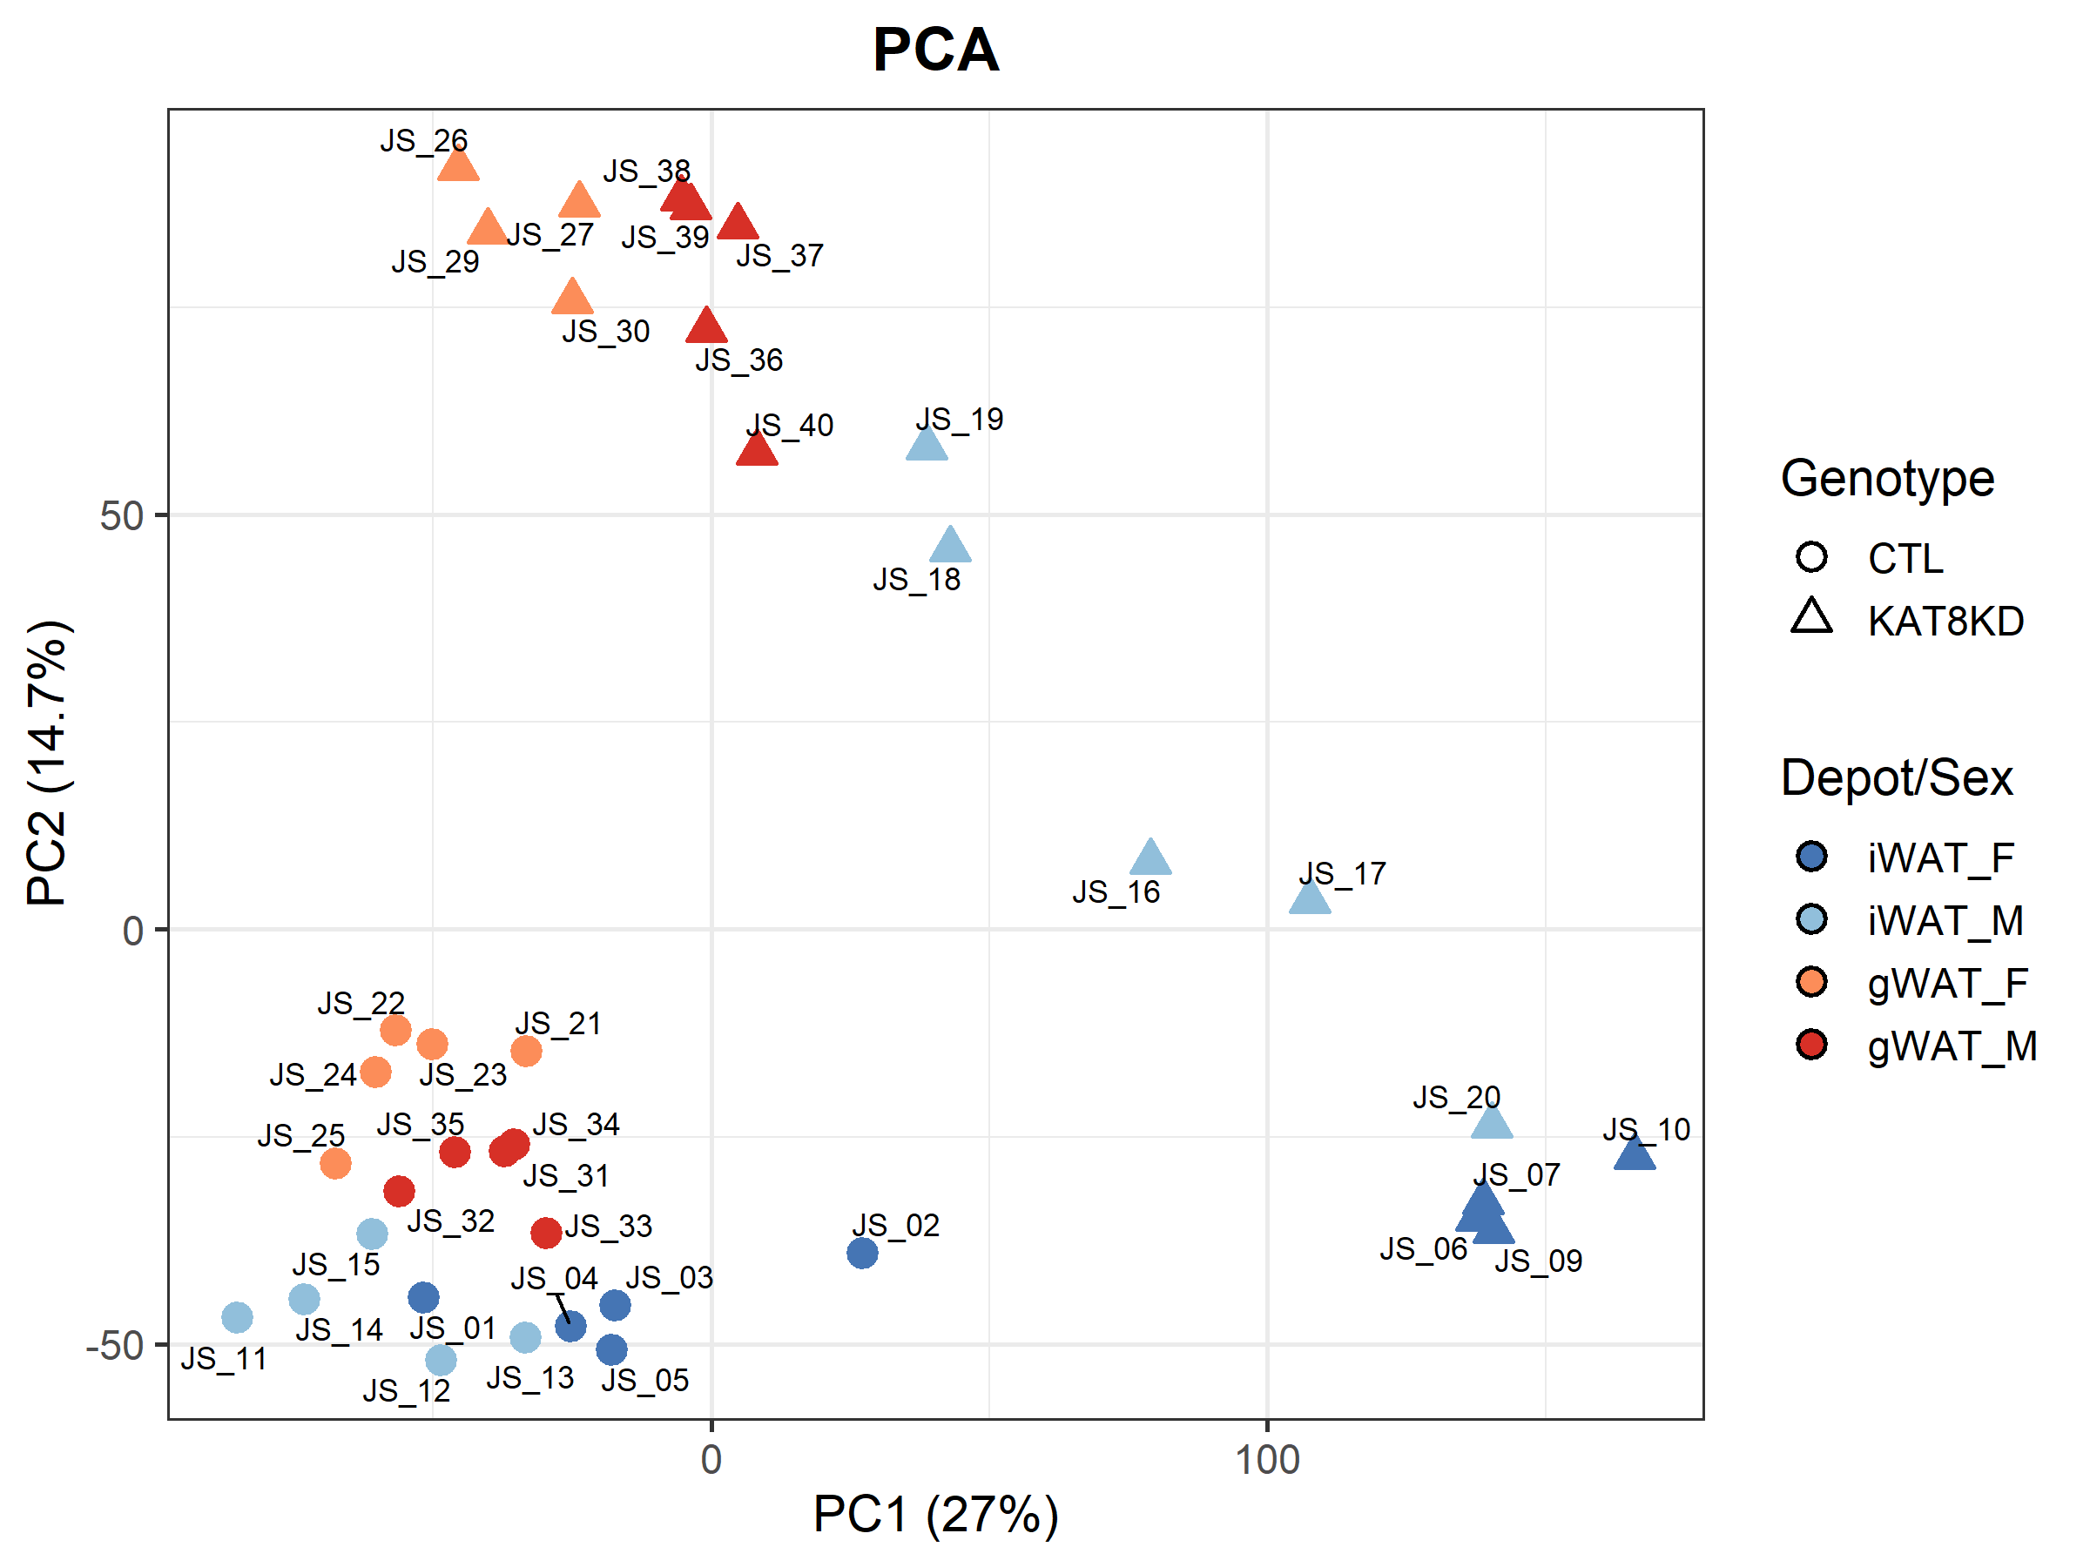
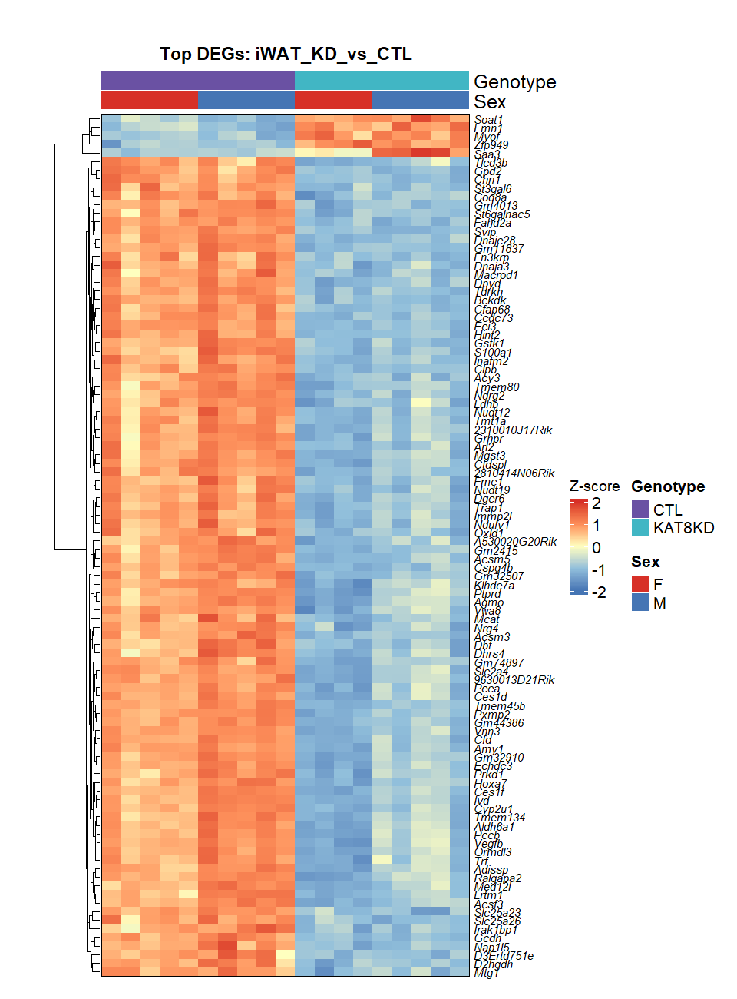
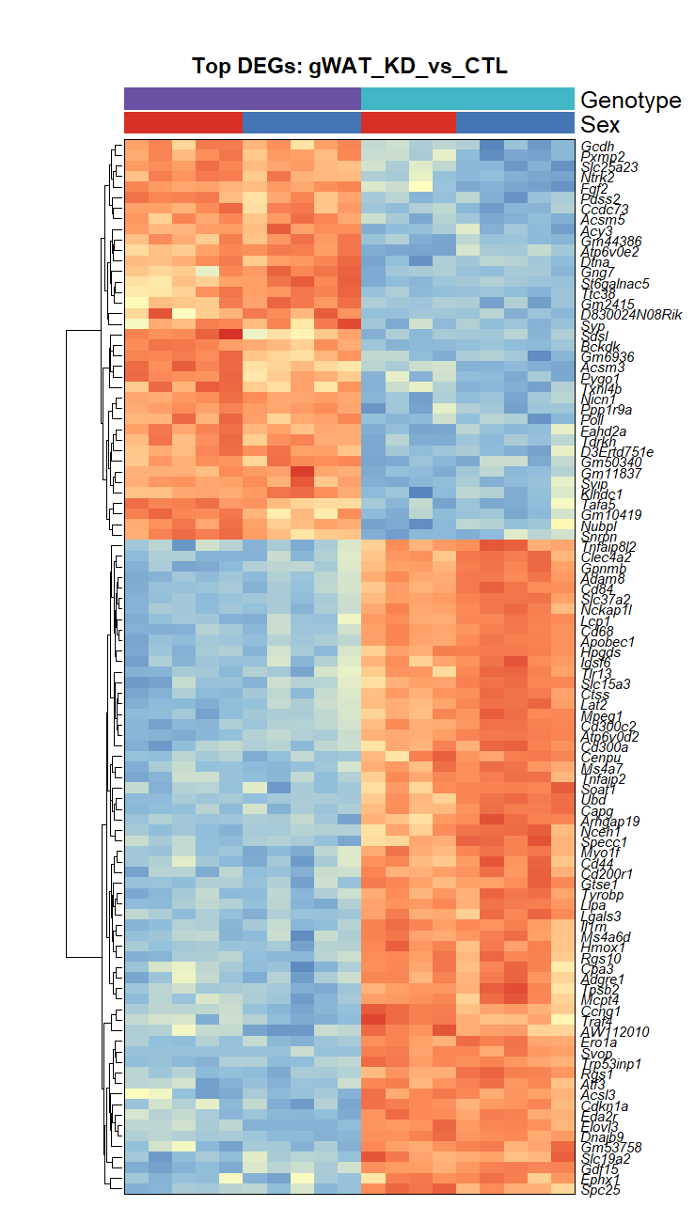
A
B

